Slide 1

FreeMe
A Multiscale Model for the Etching Mechanism of a Piranha Solution
on an ABS Substrate
IDENER
FRANCISCO DANIEL GARCÍA ROMERO

Slide 2
Motivation and context
Traditional metallisation techniques rely on hazardous substances (e.g. Cr⁶⁺, Pd)
Safer and greener alternatives are urgently needed in polymer surface treatment
Piranha solutions (H₂SO₄ + H₂O₂) offer a metal-free oxidative method to increase surface energy.
Understanding their interactions at molecular level can accelerate their development

Slide 3
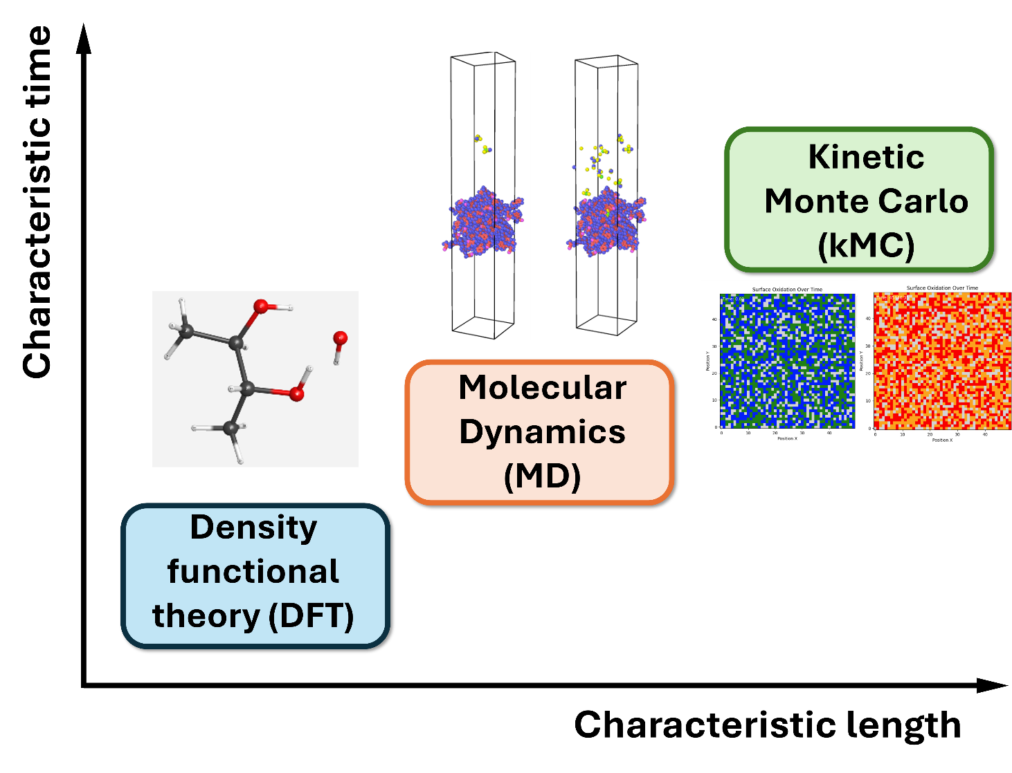
Objective & multiscale approach
DFT → Reaction mechanism at the molecular level
MD → Dynamic interaction with ABS surface
kMC → Surface oxidation over time

Slide 4
DFT modelling
ABS reactions studied
Reaction 1: Oxidation of Acrylonitrile
$$Poly−acrylonitrile \underset{→}{Piranha attack} Amide derivative$$
Reaction 2: Oxidation of Butadiene
$$Poly−butadiene \underset{→}{Piranha attack} Dialdehyde intermediate \underset{→}{Further oxidation} 2 carboxylic acids$$
Reaction 3: Electrophilic sulfonation of Styrene
$$Poly−stryrene \underset{→}{Piranha attack} Sulfonated aromatic ring$$
Elementary reaction steps were simulated with NWChem to obtain activation energies and rate constants.

Slide 5
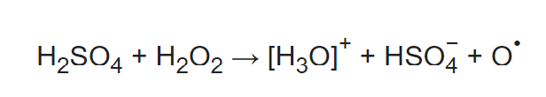

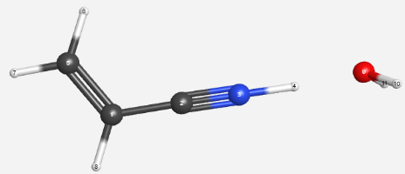
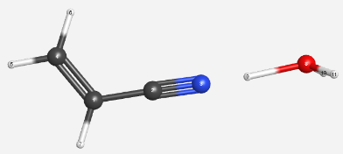
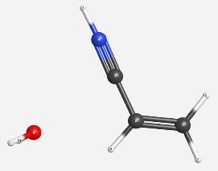
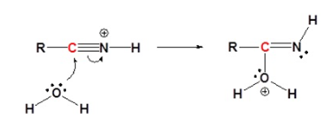
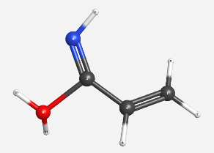
DFT: Reaction mechanism of acrylonitrile
Piranha solution
A1. Protonation
A2. Nucleophilic attack by water

Slide 6
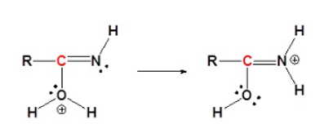
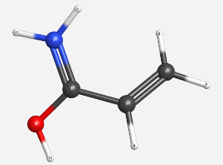
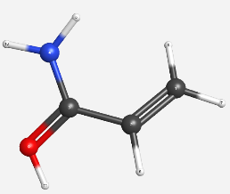
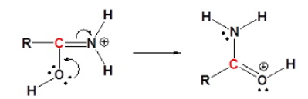
DFT: Reaction mechanism of acrylonitrile
Piranha solution
A3. Proton transfer
A4. Resonance

Slide 7
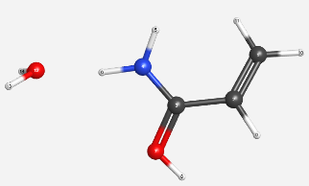
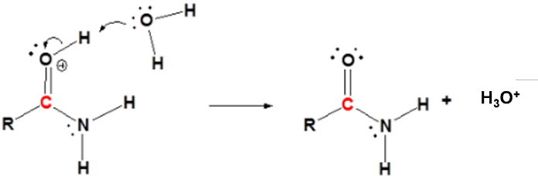
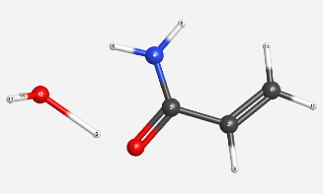
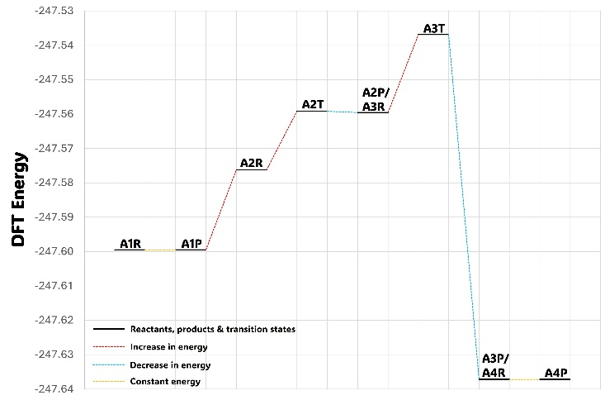
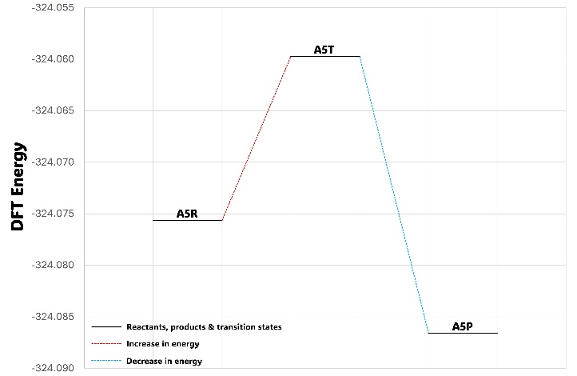
DFT: Reaction mechanism of acrylonitrile
Piranha solution
A5. Deprotonation

Slide 8
DFT: General procedure
Procedure applied to all reaction steps
Geometry optimisation of reactants and products
Vibrational frequency analysis to confirm stability
Transition state search from both sides
Validation via single imaginary frequency
Energy of activation calculated for each step
Computational details
Software: NWChem (run via WebMO)
Basis set: initially 6-31++G**, later replaced by 6-31G*
Reason: 6-31G* provided comparable activation energies with faster convergence
Gibbs Free Energy approximated by DFT energy (enthalpy and entropy corrections negligible)

Slide 9
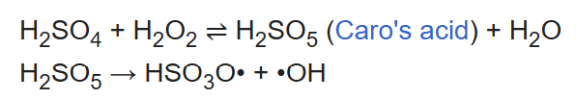
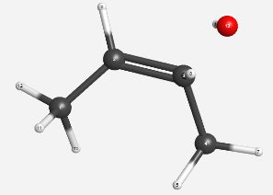
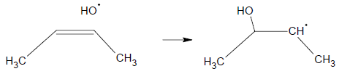
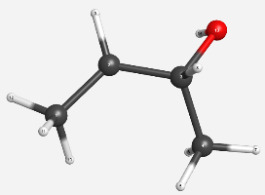
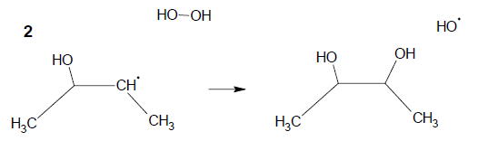
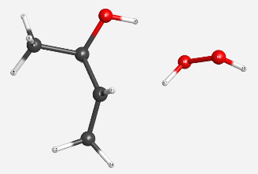
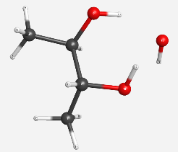
DFT: Reaction mechanism of butadiene
B1.
Piranha solution
B2.

Slide 10
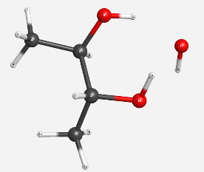
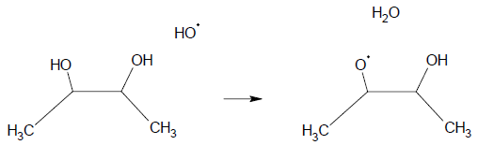
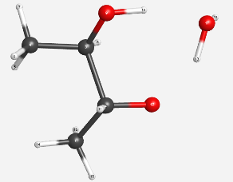
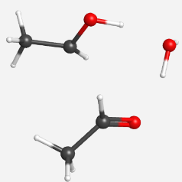
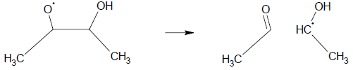
DFT: Reaction mechanism of butadiene
B3.
Piranha solution
B4.

Slide 11
DFT: Reaction mechanism of butadiene
B2T
B2R
B3T
B2P/B3R
B4T
B4P
B3P/B4R

Slide 12
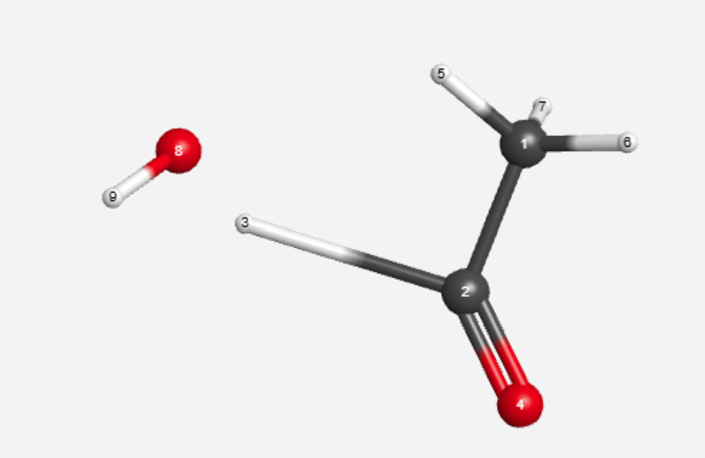
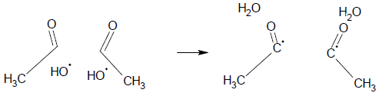
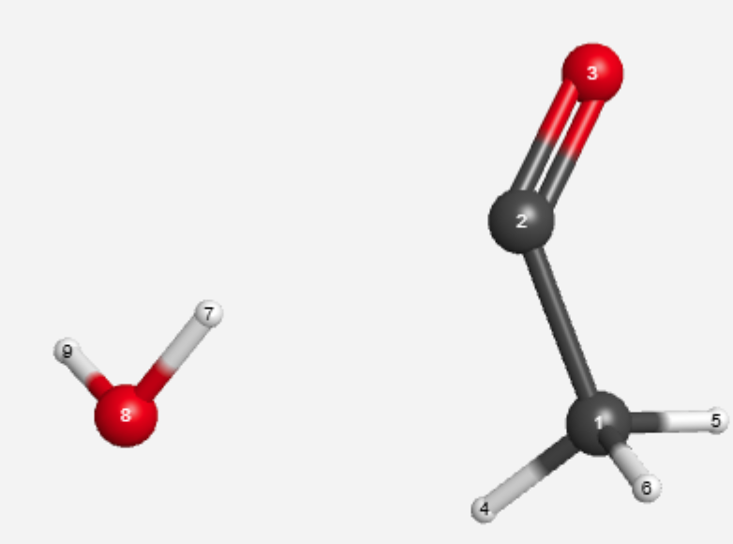
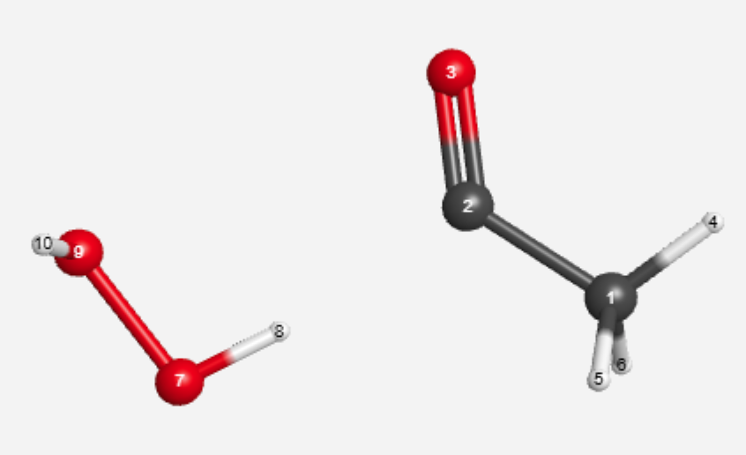
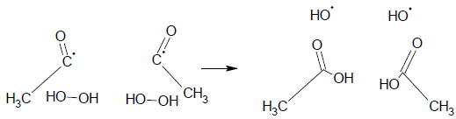
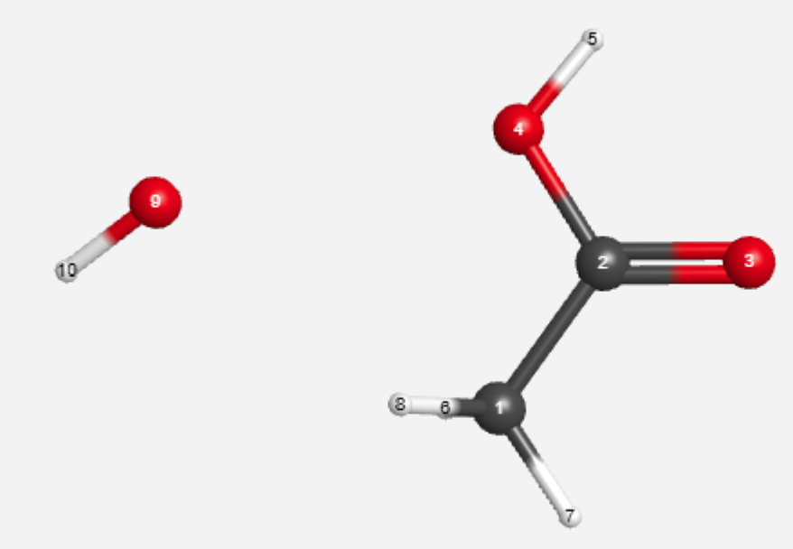
DFT: Reaction mechanism of butadiene
C1.
Piranha solution
C2.

Slide 13
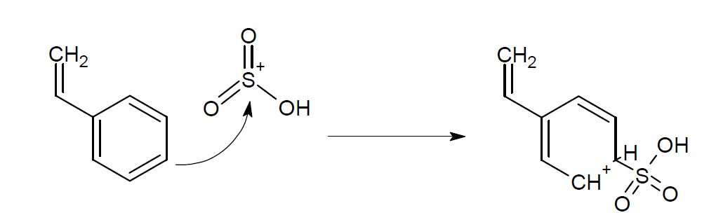
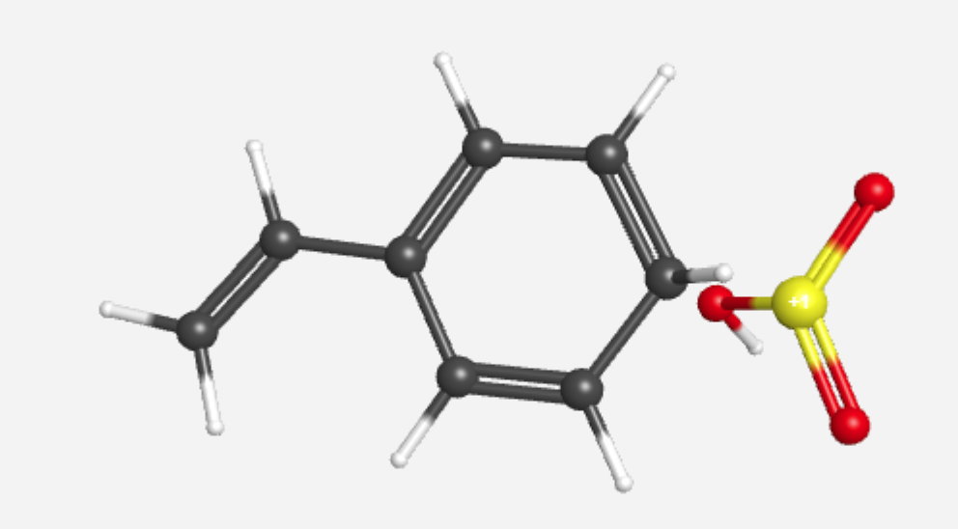
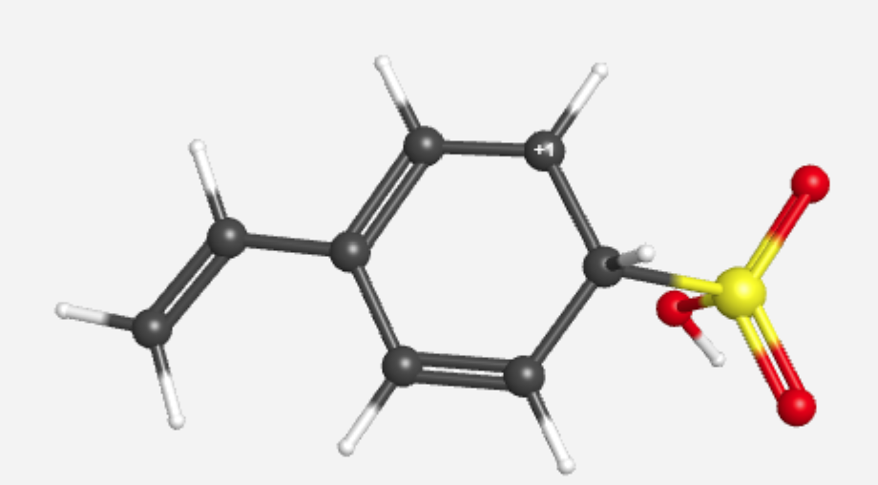
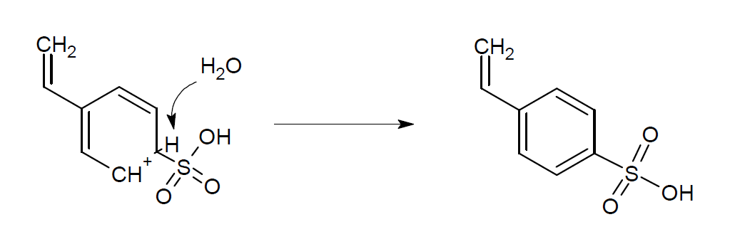
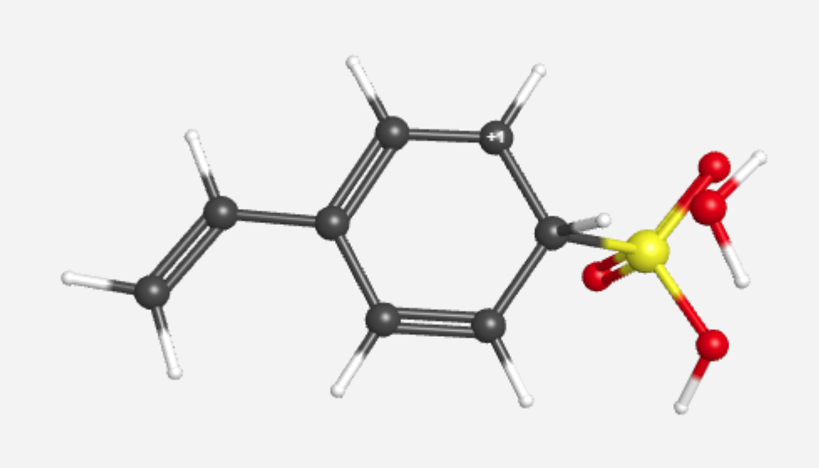
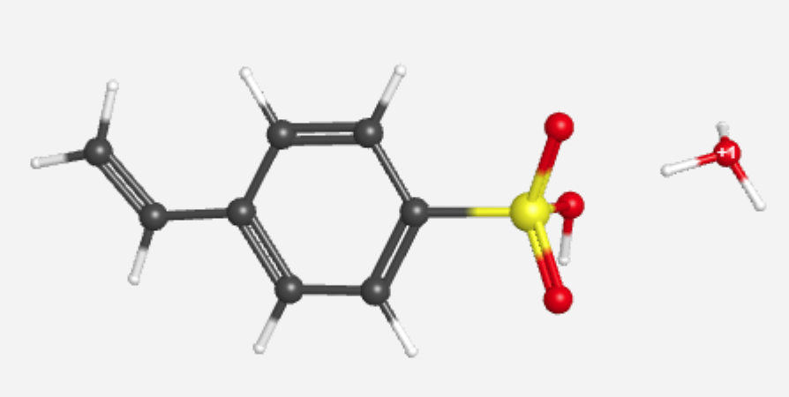
DFT: Reaction mechanism of styrene
P1.
P2.

Slide 14
ABS block built from 70 monomers using OPLS
Reactive etching simulated using ReaxFF
“Molecular gun” approach used to simulate impact
Different H₂SO₄:H₂O₂ ratios and energies tested
Analysis: MSD, diffusion, penetration, mass loss, species evolution
Molecular dynamics: Overview

Slide 15
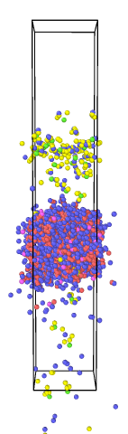
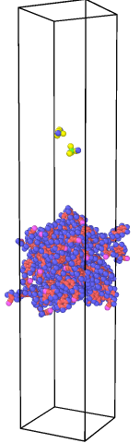
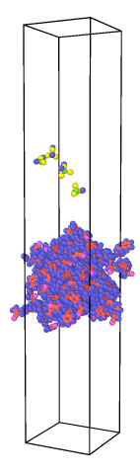
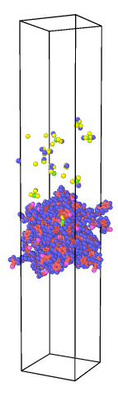
The method used to introduce the piranha solution molecules is based on adding them at the top surface of the simulation box, with randomly selected (x,y)-coordinates and a constant incident energy, with an established time between insertions.
Different concentrations were considered: 4:1, 5:1, 7:1, 10:1; with around 55-60 total piranha solution molecules introduced for each case. And different insertion energies are tested.
After all molecules are inserted, the simulation keeps running to analyse the etching process.
Etching time evolution
Excessive energy case

Slide 16
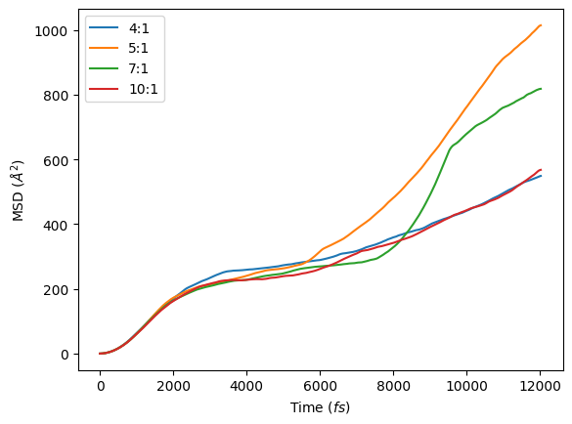
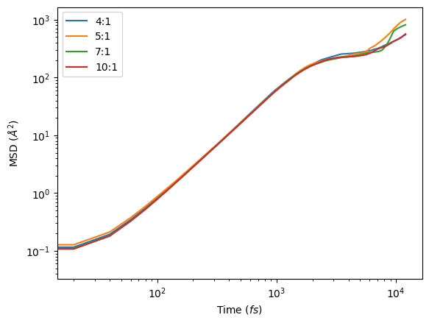
Molecular dynamics: MSD and diffusion
0.4 eV

Slide 17
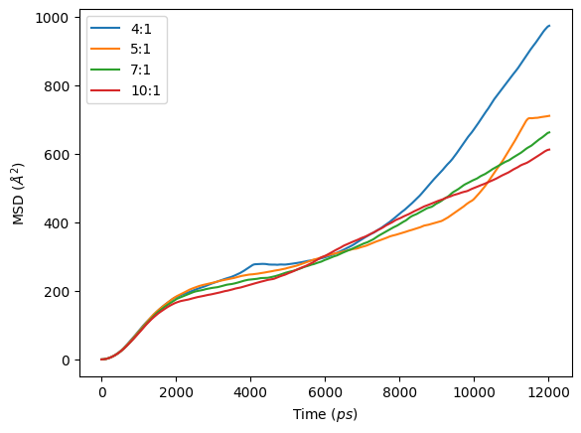
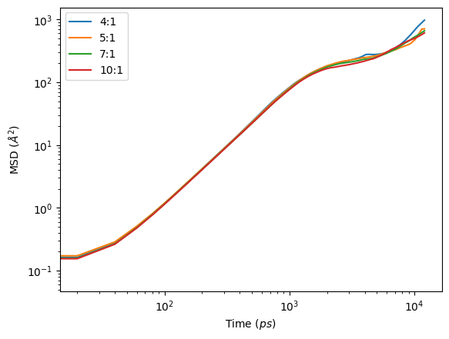
Molecular dynamics: MSD and diffusion
0.6 eV

Slide 18
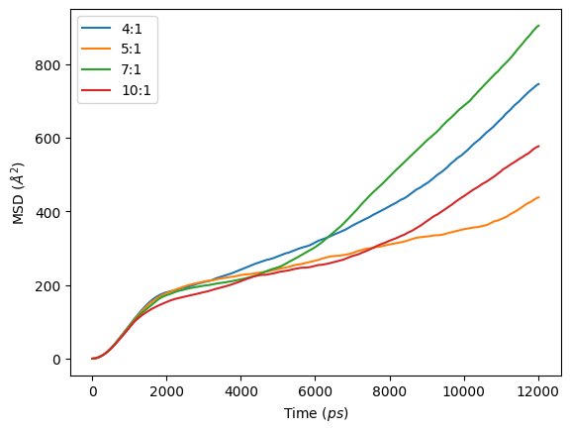
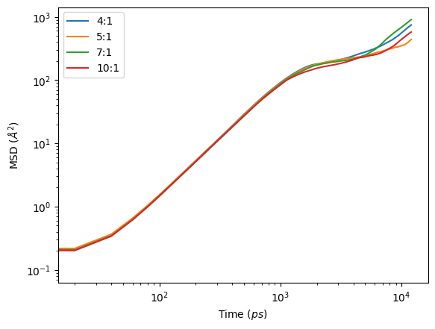
Molecular dynamics: MSD and diffusion
0.8 eV

Slide 19

Molecular dynamics: MSD and diffusion

Slide 20




Molecular dynamics: Penetration depth

Slide 21

Molecular dynamics: Penetration depth

Slide 22

Molecular dynamics: Species analysis

Slide 23

Monomer distribution
Rate calculation
Random event takes place
Update surface
Repeat process
Kinetic Monte Carlo
$$k=κ\frac{k_{B}∙T}{h}∙e^{\frac{−∆G^{‡}}{RT}}$$
$${rate}_{i}=k_{i}∙\left[ABS monomer\right]=k_{i}∙ N_{i}$$

Slide 24


Kinetic Monte Carlo

Slide 25
PRESENTER: Francisco Daniel García Romero (francisco.garcia@idener.ai)
TEAM: Israel Bellanato (israel.bellanato@idener.ai); Andrea Martos (andrea.dominguez@idener.ai); Albert Sabadell (albert.sabadell@idener.ai)

