Slide 1

Surfaces, Interfaces & Coatings Technologies
International Conference
A process optimization tool for emerging Plating on Plastics Processes
24 April 2025
Albufeira, Portugal
EXELISIS
Kostas Pyrgakis

Slide 2

CONTENTS
Etching technology introduction
Models development
Example

Slide 3
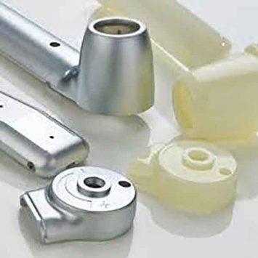
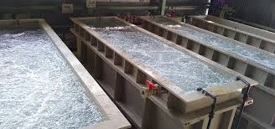
Plating on Plastics (PoP)
Plastics: low density, lightweight, low cost
Metal coating:
  Protection: wear resistance and corrosion
  shiny, polished, aesthetic
Everyday examples
Plastic before/after plating
Plating baths

Slide 4


Plastics Etching Technology
Technology by

Slide 5
Plating on Plastics (PoP)
Technology by
Conventional Approach
Etching
with Cr⁶⁺
Activation-Reduction
with Pd
& Sn
Plating
Etching with Cr⁶⁺
  50-70 ºC – high risk environment
  Carcinogenic and highly toxic
Activation with Pd
  Critical Raw material
Indispensable Need for:
SSbD PoP
Non-toxic & environment
REACH compliant
Abundancy

Slide 6

Plating on Plastics (PoP)
Technology by
Conventional Approach
Etching
with Cr⁶⁺
Activation-Reduction
with Pd
& Sn
Plating
Etching
with
Activation
with
Reduction
Plating
Novel
Technology
Piranha Solution
(H2O2-H2SO4)
Ni Salts
NaBH4

Slide 7
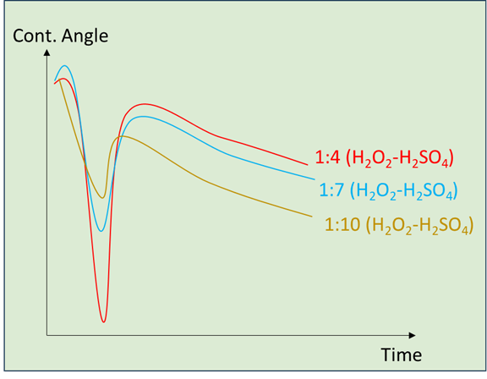
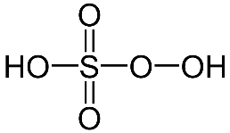
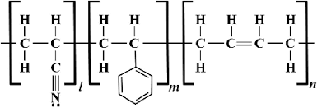
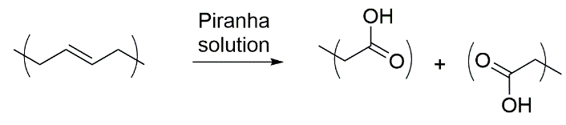




Technology by
Etching with Piranha (H₂O₂-H₂SO₄)
$$H2O2$$
$$H2SO4$$
Cleavage of double bonds
Hydrophilic groups (-COOH, -OH)
Further activation with metal ions
micro-/nano-sized cavities
surface area ↑
$$HO−$$
$$HSO4−$$
Etching
Performance
Hydrophilicity
Contact Angle
HO
OH
ABS
butadiene

Slide 8
Technology by
Activation with Ni Salts
[NiA]
[NiA]
Hydrophilic groups (-COOH, -OH)
[HA]
Chemical adsorption
Initial metal nucleation sites
Chemical identity of metalization precursor (not binding)
Ni²⁺
O
O
OH
OH
OH
C – C – C – C – C – C – C – C – C – C
Etched plastic surface
Uniform distribution
Homogeneous growth

Slide 9
Technology by
Reduction
Reduction to metallic state (M^{X+} → M⁰)
Nucleation sites for metal coating (electroless step)
Strong reducing agent (NaBH4, KBH4)
NaBH4 – reducing power & low price
Na⁺
BH4⁻
Na⁺
BH4⁻
Na⁺
BH4⁻
e⁻
e⁻
Ni²⁺
Ni²⁺
Ni²⁺
Ni⁰
Ni⁰
Ni⁰
O
O
O
O
O
O
O
O
O
O
O
O
C – C – C – C – C – C – C – C – C – C
C – C – C – C – C – C – C – C – C – C
Etched plastic surface
Etched plastic surface

Slide 10

Technology by
Platting
Step-1: NiP electroless plating
Step-2: Ni Electroplating
Anode: 𝑁𝑖⁰ ‒ e⁻ → 𝑁𝑖²⁺
Cathode (item): 𝑁𝑖²⁺ + e⁻ → 𝑁𝑖⁰
𝑁𝑖²⁺+𝐻₂𝑃𝑂₂⁻+𝛨2𝛰→𝑁𝑖⁰+ 𝐻₂𝑃𝑂₃⁻+ 2𝐻⁺
𝐻₂𝑃𝑂₂⁻+$\frac{1}{2}$𝐻₂→𝑃 (𝑠)+ 𝛨₂𝛰+𝑂𝐻⁻
5+ μm
Ni coating
5 μm
NiP coating

Slide 11


Technology by
Modeling Etching Technology
From Lab to Computer
Decision Support Tools

Slide 12

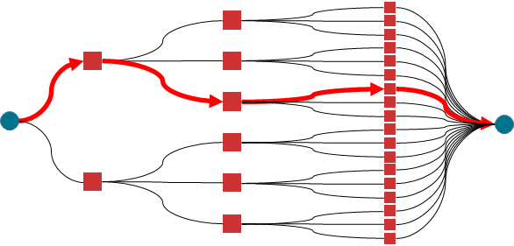

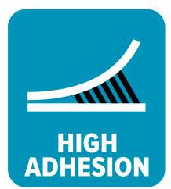



Decision Support Tool (DST)
Etching Technology
Inputs
DST
  Outputs
User-defined
Items characteristics
Specifications
Property models
Unit operation models
Process Optimization
  Concentrations
  Dilution rates
  Operating times
  Volumes
  Operating conditions
  Achieved Specifications
Automotive
equipment
3 MPa

Slide 13

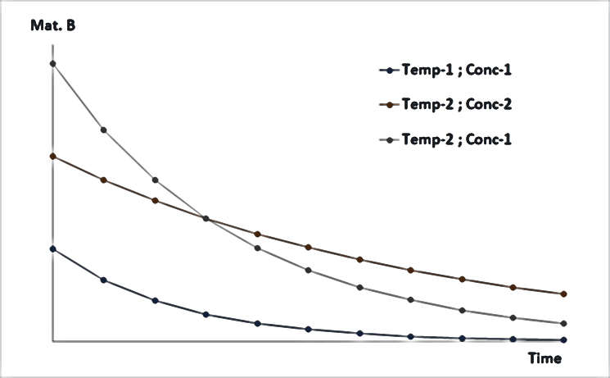
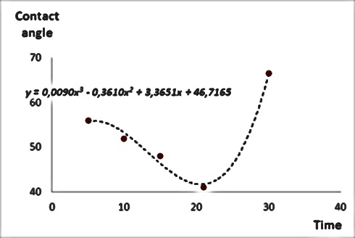
Decision Support Tool – Background
Fed with:
Experiments database
Conditions per Stage
Specifications (Contact Angel, Adhesion, Thickness)
f (x1,x2,x3,…,xN)
g (x1,x2,x3,…,xN)
Mass Balances
Kinetics
Electrochemistry
State of the Art Models
Unconventional data
Combinatorial insights
Operating conditions → Outputs
Regression Models

Slide 14
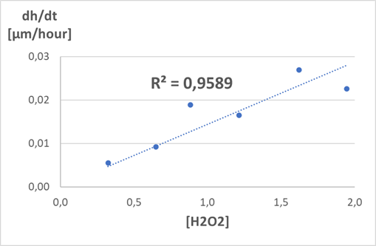
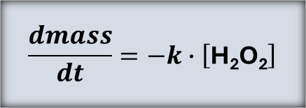
Etching stage
$$\text{H}\text{2}\text{O}\text{2}\text{ + 2}∙\text{H}\text{2}\text{SO}\text{4} → 2∙H^{+} \text{+ 2}∙{\text{HSO}}_{4}^{−}\text{+ }2∙{\text{OH}}^{−}$$
[H₂O₂-H₂SO₄]
Assumptions
1:4 H₂O₂:H2SO4 → > stoichiometry
>14 H₂O₂ molecules/monomer
Monomer-by-monomer ceasing
SEM & Optical microscope
Surface characteristics
Holes & Diameter ranges
Scaling etchning performance - [H2O2] ↑
  D ↑
  Number of holes ↓↓
$$\frac{dmass}{dt}=−k∙\left[\text{H}\text{2}\text{O}\text{2}\right]$$

Slide 15
Contact Angle property model
Cont. Angle
Time
Initial plastic substrate
Initiating etching
Intensive etching
Smoothed surface
Gradual cavities creation

Slide 16
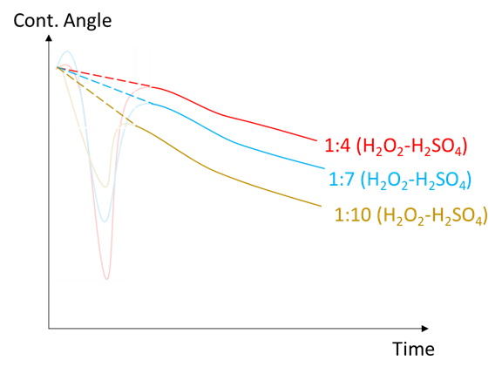
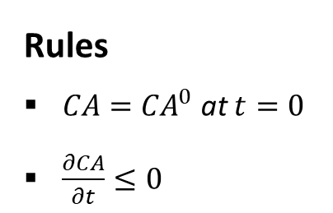
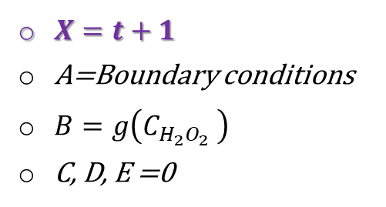
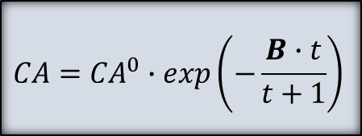
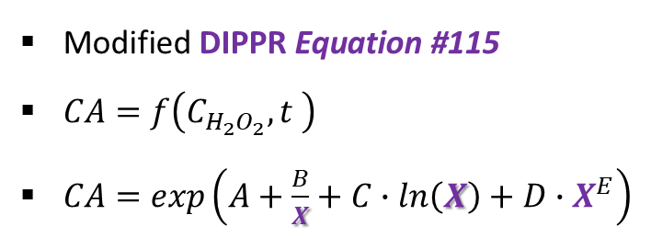
Contact Angle property model
Contact Angle estimation model
$\text{Modified} \text{DIPPR} \text{Equation}\text{ \#115}$
$CA=f\left(C_{H_{2}O_{2}},t \right)$
$CA=exp\left(A+\frac{B}{X}+C∙ln\left(X\right)+D∙X^{E}\right)$
Rules
$CA={CA}^{0}$ at $t=0$
$\frac{∂CA}{∂t}≤0$
There is a pattern
$X=t+1$
A=Boundary conditions
$B=g\left(C_{H_{2}O_{2}} \right)$
C, D, E =0
$$CA={CA}^{0}∙exp\left(−\frac{B∙t}{t+1}\right)$$

Slide 17
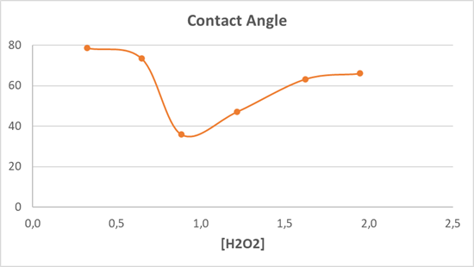
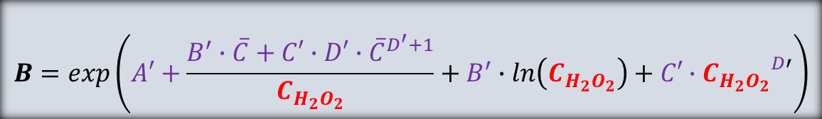
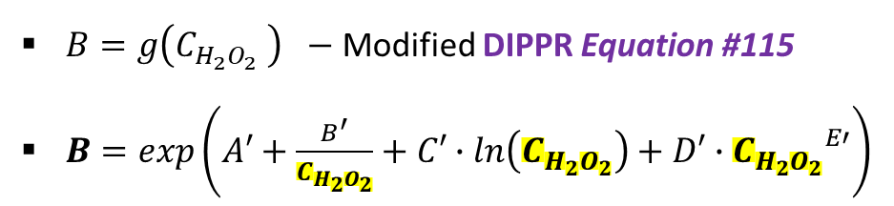
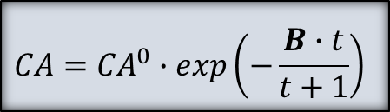


Contact Angle property model
$$CA={CA}^{0}∙exp\left(−\frac{B∙t}{t+1}\right)$$
Parameter estimation model
$B=g\left(C_{H_{2}O_{2}} \right) −$ Modified DIPPR Equation #115
$B=exp\left(A′+\frac{B^{′}}{C_{H_{2}O_{2}}}+C′∙ln\left(C_{H_{2}O_{2}}\right)+D′∙{C_{H_{2}O_{2}}}^{E′}\right)$
$$\overline{C}$$
Rules
Optimal Concentration →
$$B=exp\left(A′+\frac{B^{′}∙\overline{C}+C′∙D′∙{\overline{C}}^{D^{′}+1}}{C_{H_{2}O_{2}}}+B^{′}∙ln\left(C_{H_{2}O_{2}}\right)+C′∙{C_{H_{2}O_{2}}}^{D′}\right)$$
$${\left.\frac{∂CA}{∂C_{H_{2}O_{2}}}\right]}_{C=\overline{C}}$$

Slide 18
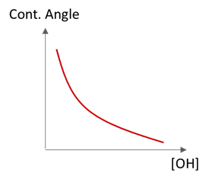
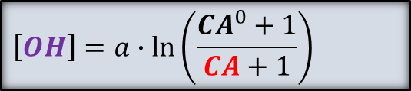
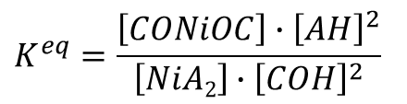


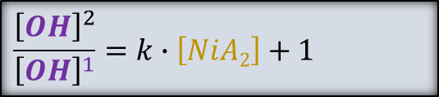
Activation stage
[OH] vs Cont Ang
1 (before) → 2 (after) activation
$$\left[OH\right]=a∙\ln\left(CA+1\right)+b$$
${\left[OH\right]}^{2}=\left(\frac{\ln\left({CA}^{2}+1\right)−\ln\left({CA}^{0}+1\right)}{\ln\left({CA}^{1}+1\right)−\ln\left({CA}^{0}+1\right)}\right)$ $∙$ ${\left[OH\right]}^{1}$
[NiA₂]
Equilibrium
[OH] Calculation= f (CA)
[HA]
$$\left[OH\right]=a∙ln\left(\frac{{CA}^{0}+1}{CA+1}\right)$$
[HA]
$$NiA2+2 ∙COH →CONiOC+2∙AH$$
Ni²⁺
O
O
$$K^{eq}=\frac{\left[CONiOC\right]∙{\left[AH\right]}^{2}}{\left[NiA2\right]∙{\left[COH\right]}^{2}}$$
[OH] Before/After Activation
– C – C –
$$\frac{{\left[OH\right]}^{2}}{{\left[OH\right]}^{1}}=k∙\left[NiA2\right]+1$$

Slide 19
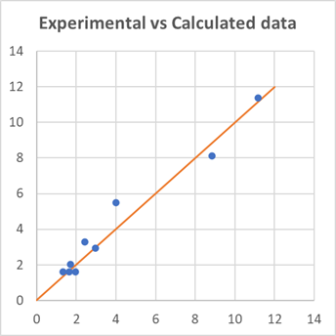
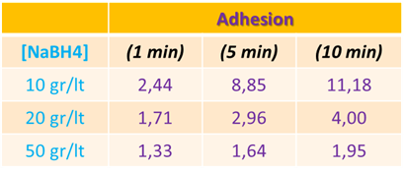
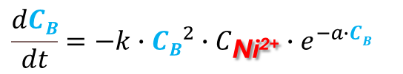
Reduction stage
Na⁺
Na⁺
Reduction reaction
BH4⁻
BH4⁻
Ni²⁺ + 2 ∙ BH₄⁻​ + 6∙H₂​O → Ni⁰ + 2 ∙ B(OH)₃​ + 7H₂​
Ni²⁺
2∙e⁻
Ni⁰
O
O
O
O
Undesired parallel reaction - [NaBH4] ↑↑↑
– C – C –
– C – C –
Ni²⁺ + BH₄−​ → NiB + H₂​ + byproducts
Kinetic model fitting
Experiments
R²=0,9626
$$\frac{dCB}{dt}=−k∙{CB}^{2}∙C_{\text{Ni}\text{2+}}∙e^{−a∙CB}$$

Slide 20





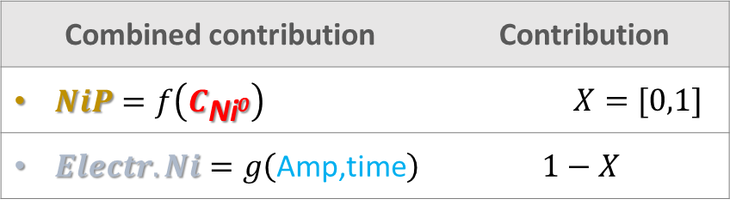
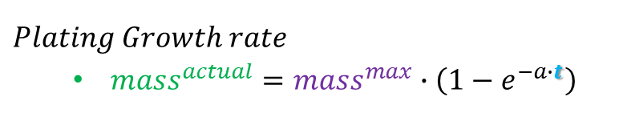
Plating stage
$$NiP$$
$$Electro$$
Combined contribution | Contribution
$NiP=f\left(C_{\text{Ni}\text{0}}\right)$ | $$X=[0,1]$$
$Electr.Ni=g\left(\text{Amp}\text{,}\text{time}\right)$ | $$1−X$$
$Adhesion=x∙a∙C_{\text{Ni}\text{0}}+(1−x)∙b∙$ $g\left(\text{Amp}\text{,}\text{time}\right)$
  $g\left(\text{Amp}\text{,}\text{time}\right)={mass}^{actual}$
$$Plating Growth rate$$
  ${mass}^{actual}={mass}^{max}∙\left(1−e^{−a∙t}\right)$
Electroplating
Δh [μm]
Adhesion
${mass}^{max}={mass}^{theo}=\frac{I∙s∙t∙Mr}{2∙Fa}$
Fixed NiP Recipe
5 μm
Plastic substrate

Slide 21
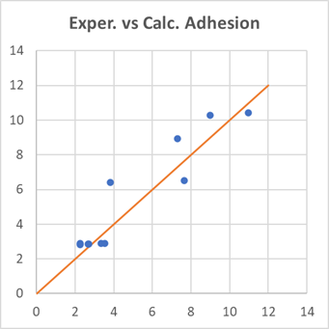
Plating stage
Combined contribution | Contribution
$NiP=f\left(C_{\text{Ni}\text{0}}\right)$ | $$X=[0,1]$$
$Electr.Ni=g\left(\text{Amp}\text{,}\text{time}\right)$ | $$1−X$$
$$Adhesion=x∙a∙C_{\text{Ni}\text{0}}+(1−x)∙b∙\frac{I∙s∙t∙Mr}{2∙Fa}∙\left(1−e^{−a∙t}\right)$$
R²=0,8539
Electroplating
Δh [μm]
Adhesion
Fixed NiP Recipe
5 μm
Plastic substrate

Slide 22
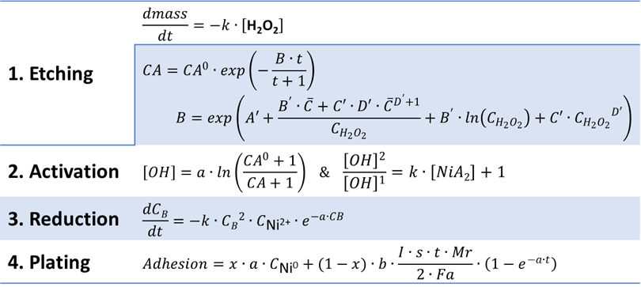

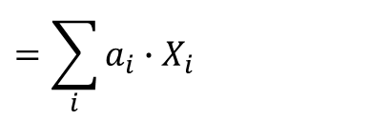
Technology Simulation Model
w1
on/off
Economic
on/off
w2
Optimize [Objective] = Safe & Sustainable by Design
User Options
Environmental
on/off
w3
Subject to
Safety
SSbD (weighted)
i.e. $\left[\text{H}\text{2}\text{O}\text{2}\right]$, $\left[NiA2\right]$, $CB$
Economic
$$=\sum_{i}{a_{i}}∙X_{i}$$
Environmental
Safety
Economic
Environmental
Safety
Indicators

Slide 23


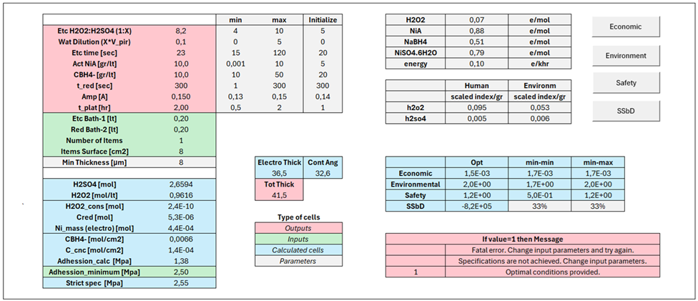

Decision Support Tool
User selects type of Objective
to optimize the design
Web Platform
Available Online
Free period for Demo
Parameters & Variables
Equations system
Background code → VBA
  Optimization problem
  Interface with users

Slide 24
Example
33%-33%-33%
Econom
Envir/Safety
SSbD
Automotive equipment
Piranha (H₂O₂-H₂SO₄)
1:7,1
1:4
1:4
Dilution (Piranha-Water)
1:0,5
1:1,5
1:1,4
Volume (lt)
25
25
1:2,1
Inputs set by USER
Number of Items | 100
Item surface | 20 cm² (2 x 10 x 1 cm)
Thickness Specification | 10 μm
Adhesion Specification | 2,5 MPa
Etching time [sec]
21
120
120
Activation: NiA [gr/lt]
9,7
10
10
Reduction: NaBH4 [gr/lt]
10
10
10
Reduction time [sec]
300
300
300
Plating: I density [A/dm2]
1,54
6
1,54
Plating time [hr]
2
2
2
Thickness [μm]
10
24,4
10
Adhesion [Mpa]
2,55
2,55
2,55

Slide 25

Example
33%-33%-33%
Econom
Envir/Safety
SSbD
Automotive equipment
Piranha (H₂O₂-H₂SO₄)
1:6,9
1:4
1:4
FreeMe Decision Support Tool
Solution <1 sec
Dilution (Piranha-Water)
1:1
1:2,1
1:2,1
Inputs set by USER
Etching bath | 400 lt
Reduction bath | 400 lt
Number of Items | 10,000
Item surface | 20 cm² (2 x 10 x 1 cm)
Thickness Specification | 14 μm
Adhesion Specification | 2,5 MPa
Etching time [sec]
15
120
15
Activation: NiA [gr/lt]
10
10
10
High throughput analysis
Integrated with Real-time monitoring
Live process optimization & management
Everyday planning
Reduction: NaBH4 [gr/lt]
24,2
24,2
24,2
Reduction time [sec]
300
300
300
Plating: I density [A/dm2]
0,15
0,15
0,15
Plating time [hr]
1,90
2
1,94
Thickness [μm]
14
14,6
14
Adhesion [Mpa]
2,55
2,55
2,55

Slide 26
NAME: Kostas Pyrgakis, EXELISIS
EMAIL: kostas.p@exelisis.gr

