Slide 1


Synthesis of Bio-Based Thermosetting Resins for Advanced Composite Applications in Plating on Plastics (PoP) Processes
24TH APRIL 2025
ALBUFEIRA, PORTUGAL
Zoi-Lina Koutsogianni, Dimitrios Bikiaris, Konstantinos Triantafyllidis

Slide 2
Overview
Introduction to bio-based resins
Experimental Part & Results
FreeMe Project
Conclusions
FreeMe workshop, 24/04/2025

Slide 3
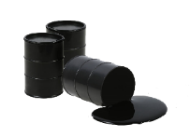








Bio-based resins
Crude oil
While the chemical structure of the resulting products may be identical, the environmental impact, carbon footprint, and resource circularity differ significantly
Biomass
Oil refinery
Bio-refinery
Monomer production
Monomer production
Polymer production
Polymer production
Plastic products
FreeMe workshop, 24/04/2025

Slide 4
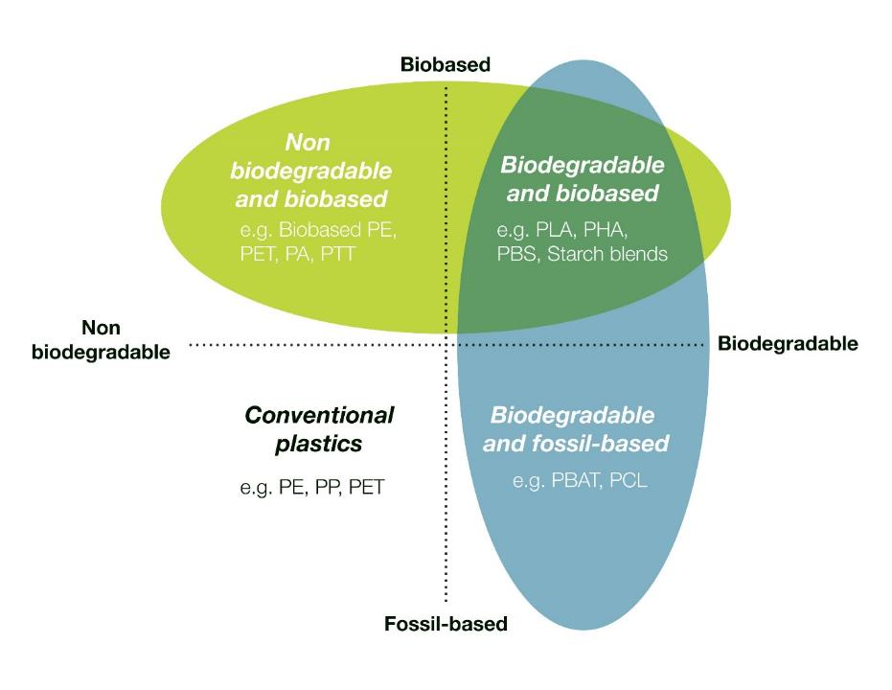
Bio-based resins
Not all bio-based plastics are biodegradable, and not all biodegradable plastics are bio-based.
(Ilyas & Sapuan, 2019)
FreeMe workshop, 24/04/2025

Slide 5
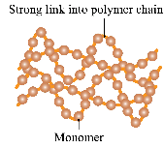
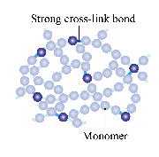
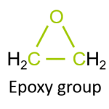
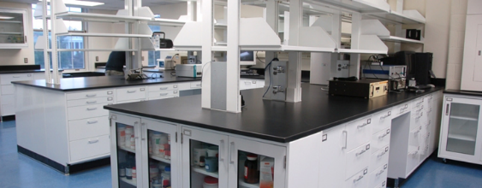



Bio-based resins
Epoxy resins: one of the main categories of polymeric materials used for the preparation of composite materials.
Highly reactive thermosetting polymers and pre-polymers
Characteristic epoxy group in their structure.
The more epoxy groups in their structure the higher the reactivity.
Weak intermolecular forces between polymer chains
No cross-links between chains
Softens when heated
Thermoplastic
Thermoset
Strong covalent bonds between polymer chains
Remains hard when heated
Properties
Applications
Mechanical properties
Excellent stability
Chemical resistance
Flame retardants
Flexibility in design
Coatings
Adhesives
Manufacturing
Aerospace and automotive industry
Sports equipment

Slide 6

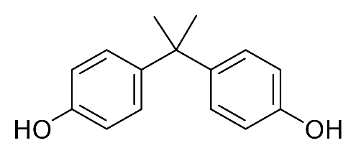
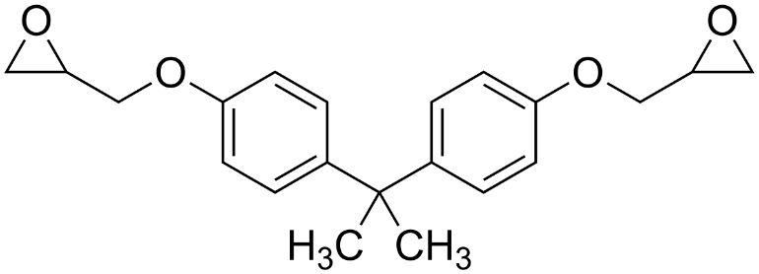
Bio-based resins
Over 90% of these epoxy materials are based on bis(4-hydroxyphenylene)-2,2-propane, known as bisphenol A (BPA).
BPA has been classified as carcinogen mutagen and reprotoxic (CMR), and is recognized as an endocrine disruptor. Consequently, many governments have recently hardened the legislation regarding the production and use of BPA, especially in baby’s bottles, food containers and medical supplies.
Growing environmental and economic concerns as well as the depletion of petrochemical resources has caused a rapid increase in the research and development of bio-based epoxy resins in recent years.
Bisphenol A
DGEBA oligomer
FreeMe workshop, 24/04/2025

Slide 7
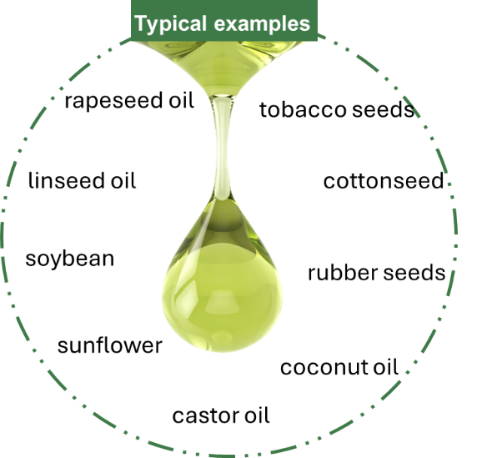


Bio-based resins
Vegetable oils
Chemical composition
Triglycerides 95-98 % (saturated fatty acids, mono- & poly- unsaturated fatty acids)
Other components 2-5 % (free fatty acids, tocopherols, polysterols, squalene, carotenoids, plenolics)
linseed oil
epoxidized linseed oil
FreeMe workshop, 24/04/2025

Slide 8
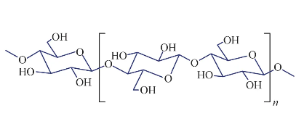
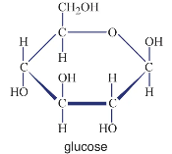
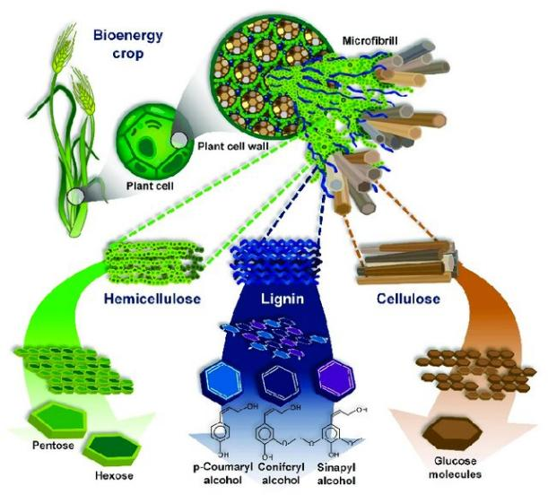
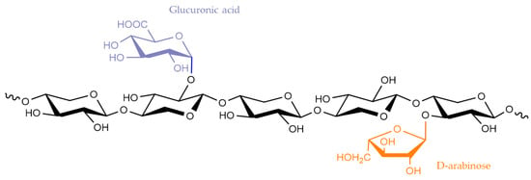
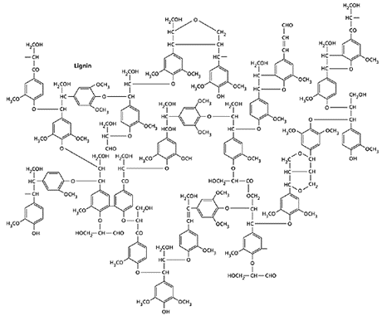
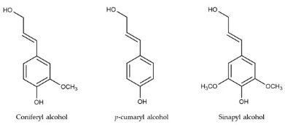
Bio-based resins
Cellulose
Lignocellulosic biomass
general formula (C₆H₁₀O₅)_{n}
30-50 %
Average MW 300000-500000
Structure of lignocellulosic biomass and its biopolymers; cellulose, hemicellulose, and lignin.
Hemicellulose
general formula(C₅H₈O₄)_{n}
20-40%
composed of various sugar monomers including glucose, galactose, mannose, xylose, arabinose, 4-O-methyl glucuronic acid, and galacturonic acid residues
Lignin
15-25%
a random, amorphous, three-dimensional polymeric network
(Source: Hernández-Beltrán, J.U. et al, Appl. Sci. 2019, 9, 3721)
The main precursors of lignin.

Slide 9
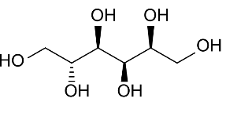
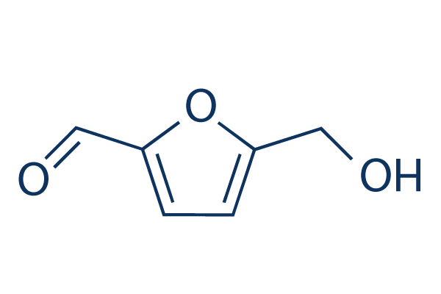
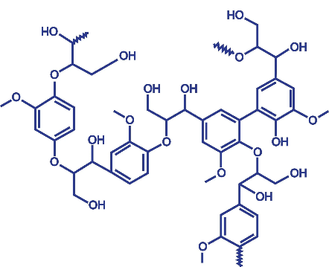
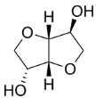
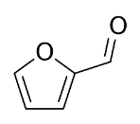
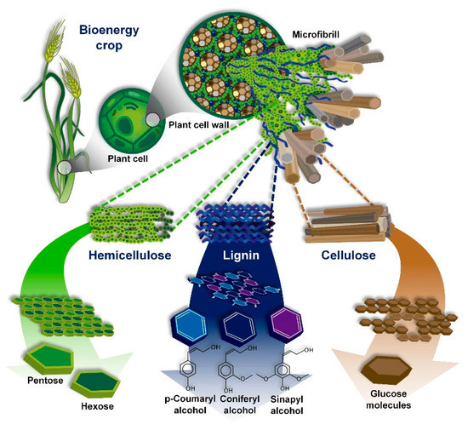
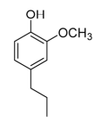
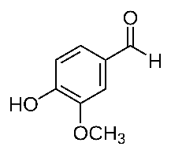
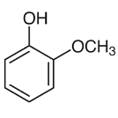
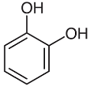
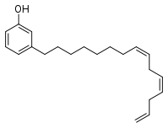
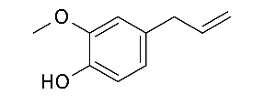


Bio-based resins
Cellulose, hemicellulose & lignin derived monomers/oligomers
D-sorbitol
5-HMF
Isosorbide
furfural
lignin
Vanillin
guaiacol
2-methoxy-4-propylphenol
Cashew nut shell liquid
Essential oils (cinnamon, basil)
catechol
Cardanol
furfuryl alcohol
Eugenol
FreeMe workshop, 24/04/2025

Slide 10


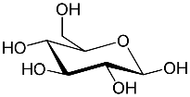
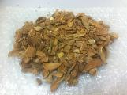
The FreeMe Project
Hydrogenation/Dehydration
€
Cellulose
Feedstock for bio-based epoxy resins
C₆ sugars
Isosorbide
Hemicellulose
C5 & C₆ sugars
Glucose
Biomass
Lignin
Phenolics
Fermentation
Itaconic acid
Sugar-derived monomers, which are low-cost and abundant, have also gained attention for epoxy prepolymer synthesis.
In this work, we have developed isosorbide and itaconic acid-based epoxy resins, and studied their properties, aiming to high biobased polymers.
FreeMe workshop, 24/04/2025

Slide 11
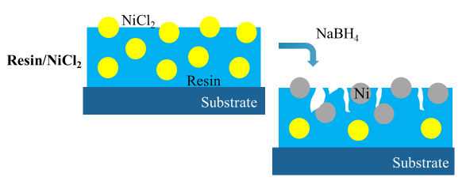
The FreeMe Project
Glycidylation
Composite formulation
with Ni-salts
Application of coating
on plastic substrate (ABS)
Reduction to Ni nuclei
and metallization
Glycidylation &
Acrylation
Isosorbide
Itaconic acid
Resin/NiCl₂
FreeMe workshop, 24/04/2025

Slide 12
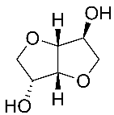
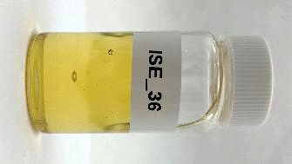

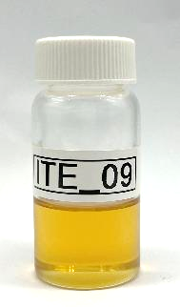
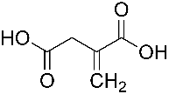

Results
+
NaOH_{(aq)}
T
Isosorbide
Epichlorohydrin
Diglycidyl ether of isosorbide
+
NaOH_{(aq)}
Catalyst, T
Itaconic acid
Epichlorohydrin
Diglycidyl ether of itaconic acid
FreeMe workshop, 24/04/2025

Slide 13
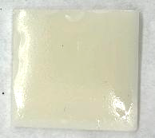
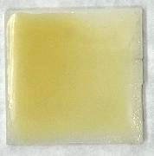
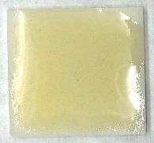
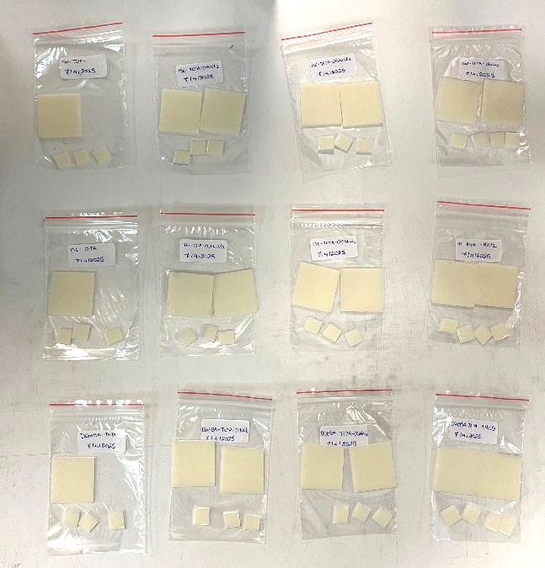
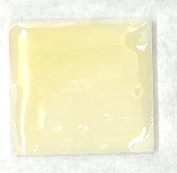
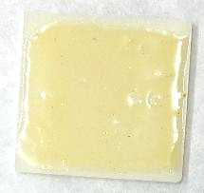
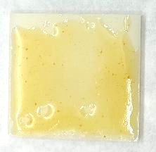
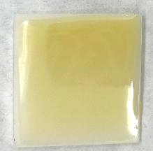
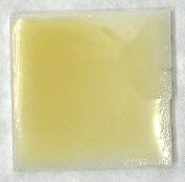
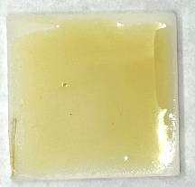
Results
Composites with NiCl₂ coated on ABS
DGEBA
0%
0.5%
1%
Isosorbide based
Coated with bar-type applicator
Coating thickness ~ 50 μm
0%
0.5%
1%
Itaconic acid based
0%
0.5%
1%
ABS substrates
FreeMe workshop, 24/04/2025

Slide 14
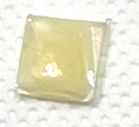
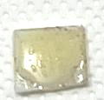
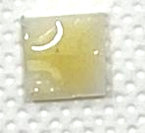
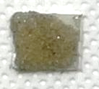
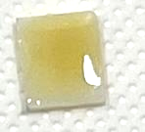
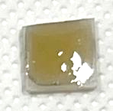
Results
SEM
DGEBA
1% NiCl₂
1% NiCl₂ -reduced
DGEBA
1%
ISE
1% NiCl₂
1% NiCl₂ -reduced
Isosorbide based
ABS
Reduction with NaBH₄
1%
ITE
1% NiCl₂
1% NiCl₂ -reduced
Itaconic acid based
1%
FreeMe workshop, 24/04/2025

Slide 15





Results
DGEBA + 0.1% Ni
ISE + 0.1% Ni
ITE + 0.1% Ni
Samples reduced and treated in Electroless Ni-P bath

Slide 16
Conclusions
We successfully synthesized and characterized bio-based thermosetting resins from isosorbide and itaconic acid.
All systems — including bio-based ones — enable nickel salt incorporation and successful reduction. The NaBH₄ treatment leads to visible metallization in all cases.
These resins demonstrated effective metallization properties when applied to ABS substrates, making them suitable for plating on plastics applications.
Our work contributes to the ongoing effort of replacing hazardous BPA with sustainable, bio-based alternatives, without sacrificing performance.
FreeMe workshop, 24/04/2025

Slide 17
NAME: Zoi-Lina Koutsogianni
EMAIL: koutsogiannizl@gmail.com
FreeMe workshop, 24/04/2025

